Slide 1

1. Introduction to Marketing Research
Frank (Yufan) Lin

Slide 2
Agenda
Introduce each other
Install iclicker reef - name, mizzou email
Fill out the bio sheet:
A fun fact about you
What’s your passion for marketing or marketing research?
Structure of the class
Syllabus
Attendance & Class participation on iClicker
Case discussion
Term project
Marketing Research Intro
Political marketing cases
Definition
Examples

Slide 3
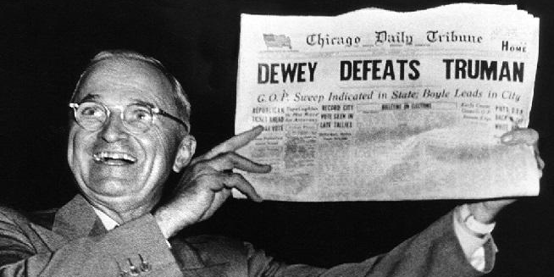
Dewey Defeats Missouri Truman
Notes:
Marketing Research can go wrong: wrong sample, wrong analysis method, biases …

Slide 4
Breakout room session & Iclicker Poll
What could be the possible reasons behind the failure in marketing research for presidential poll?
A : Questions not phrased properly
B: Sample is not representative
C: Analytical proecedure was wrong
Notes:
https://www.math.upenn.edu/~deturck/m170/wk4/lecture/case2.html

Slide 5
Outline of content
Define Marketing Research
Purpose of Marketing Research
Marketing Research Problems
Function of Marketing Research
Marketing Information System

Slide 6
Purpose of Marketing Research
To link the consumer to the marketer by providing information that can be used in making marketing decisions

Slide 7
Purpose of Marketing Research
Product (e.g., adding a new coffee bar)
Consumer segment 1 - on-campus students
(e.g., satisfaction, current shopping behavior)
Price (e.g, WTP)
Place
Promotion (e.g., social media channel)
Marketing Strategy (meet consumers needs profitably)
Product
Consumer segment 2 - off-campus students
Price/Place/Promotion
Notes:
know yourself, know your market.
Situational analysis (SWOT), Customer analysis (BADPR), Marketing Mix analysis (4P)

Slide 8
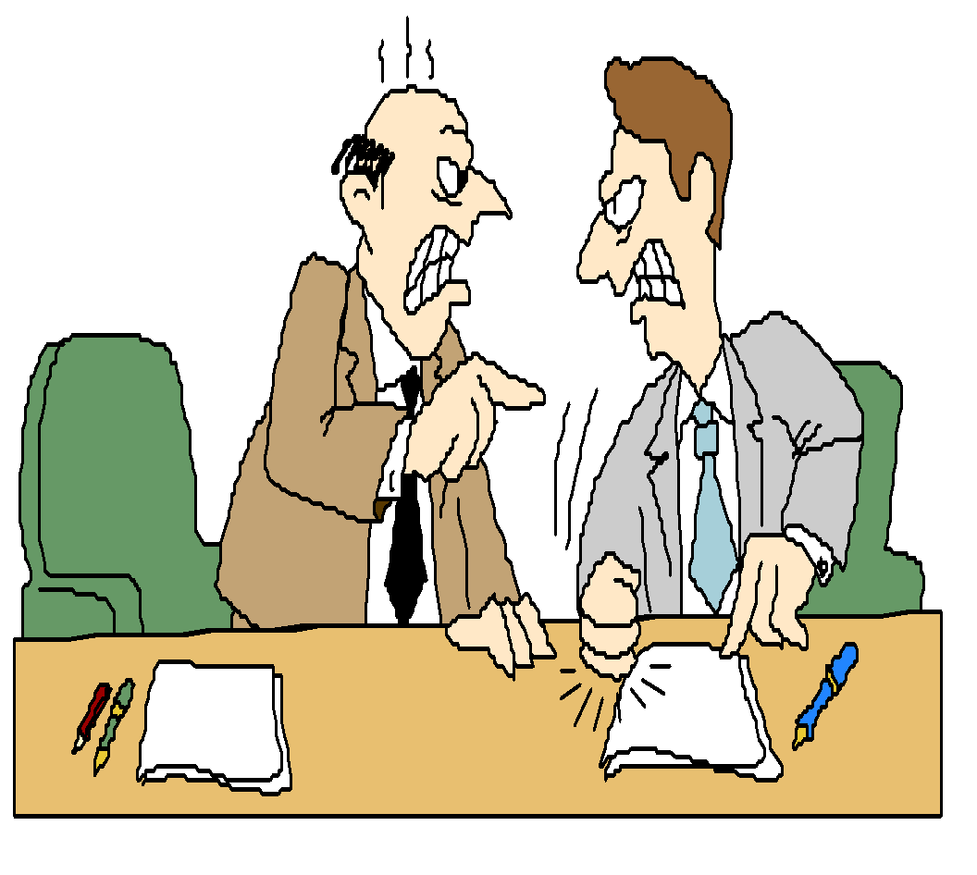
Marketing Research
The process of designing, gathering, analyzing, and reporting information that may be used to solve a specific marketing problem
Notes:
Design: specific question to be answered

Slide 9
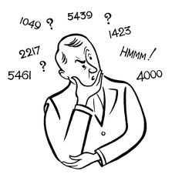



Marketing Research
Designing
Gathering
Reporting
Analyzing

Slide 10
Is This Marketing Research?
Determine optimal promotional mix
Establish market potential for a new product
Determine product pricing
Determine location of retail outlets

Slide 11




Marketing Research Examples – by third party agency for the consumers
I am thinking about going to college…which college I should target?
I want to take my friends out for dinner…I wonder what are my options?
I am going to SFO, which all places should I visit?
We want to watch the new flick and I don’t even like the promo, hmm.. Where can I get some information about it?

Slide 12
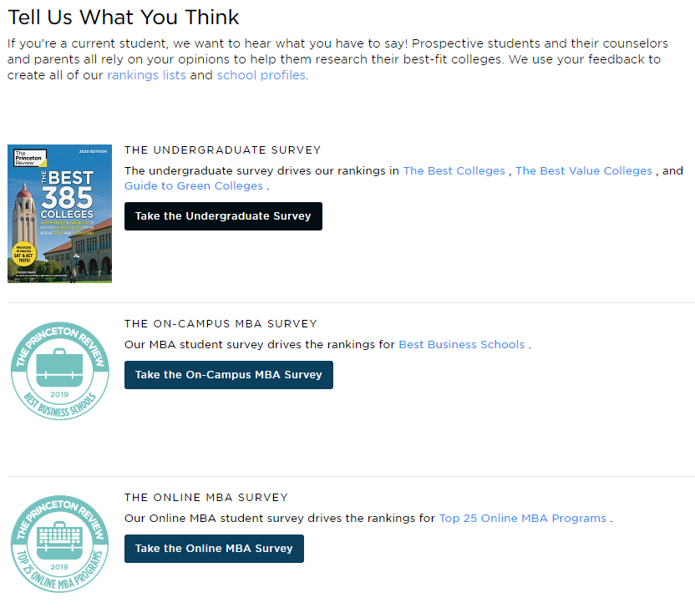
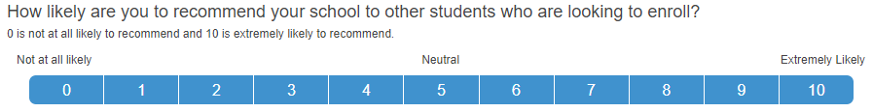

Slide 13
Recap & Next:
Syllabus (attendance, PA, CE)
Purpose and definition of marketing research
Assignment due soon: PA #1

